Slide 1
Employee Data Analysis using Excel
STUDENT NAME: Yogitha Jain. V
REGISTER NO:312212889 / unm14512022g139
DEPARTMENT: B.com 'B' ( GENERAL)
COLLEGE : Mahalashmi women's college of Arts and Science

Slide 2
PROJECT TITLE
Employee Performance Analysis using Excel

Slide 3


AGENDA
Problem Statement
Project Overview
End Users
Our Solution and Proposition
Dataset Description
Modelling Approach
Results and Discussion
Conclusion
3/21/2024 Annual Review

Slide 4

PROBLEM STATEMENT
Employee performance analysis is made to identify the performance level of each of an individual employee either by department or sector which helps to track the growth of the employee and to provide any kind of appreciation differs according to their performance.

Slide 5

PROJECT OVERVIEW
Analysing the performance of employees on considering various factors like business units, pay zone, gender and
zones.
In order to identify the trend and performance of the different category in a company. And it helps to identify which sector's performance is high, moderate and low in a vast company.

Slide 6

WHO ARE THE END USERS?
The company like IT sectors , banks , industries, marketing field.
Where it helps to analyse the current status and their organisation by hierarchy persons.

Slide 7

OUR SOLUTION AND ITS VALUE PROPOSITION
* Conditional formating.
* Filtering.
* Formula performance level
* Pivot- Summary
* Graph - data visualisation (in units)
* Pie chart - Overall performance percentage in the field.

Slide 8
Dataset Description
Employee data = Kaggle
26 features ( overall )
9 features ( considered)
* Employee ID - number
* Name - text
* Employee type.
* Performance level.
* Gender- Male and Female.
* Employee rating.

Slide 9

THE "WOW" IN OUR SOLUTION
To identify the performance level
=IFS(Z8>=5,"VERY HIGH",Z8>=4,"HIGH",Z8>=3,"MED",TRUE,"LOW")
3/21/2024 Annual Review
9

Slide 10
MODELLING
Data collection: Downloaded from Edunet dashboard.
Feature collection : Highlighted data which I required using the fill option.
Data cleaning:
* Identified the missing values using conditional formality.
* Removed or filtered the missing data using filter - filter by color.
Performance level: Performance analysis is based on Department type is filtered by gender ( Female employee) .
10

Slide 11
Summary :
Pivot table is created to summarise the data.
Row labels- It is considered as department type.
Column labels-describe the performance level.
Filter- By gender where I prefered the male employees in this data.
Values- To make a count used first name for count of employees in each field.
Visualisation:
Used the graph chart to analyze the employees (in units) in the department type category .
Used the pie chart to analyze the employees overall percentage in the department type category.

Slide 12
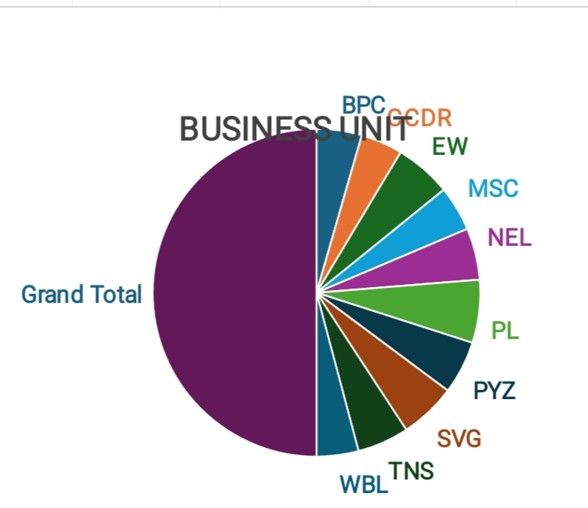
RESULTS
11

Slide 13
Conclusion:
Therefore the production department employees performs higher comparing to other department and whereas admin offices performs lower comparing to other department. .
Hence the Production department employees works more efficiently and effectively comparing to other departments according to the employee data given.

